Slide 1
An Experiment:
How to Plan it, Run it, and Get it Published
Thoughts about the Experimental Culture
in Our Community
Gerhard Weikum

Slide 2
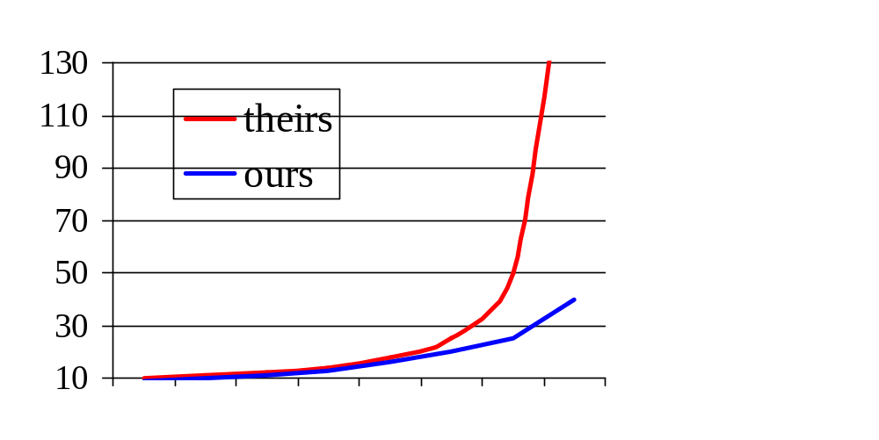
Performance Experiments (1)
throughput, response time, #IOs, CPU, wallclock,
„DB time“, hit rates, space-time integrals, etc.
speed (RT, CPU, etc.)
There are
lies, damn lies, and
workload assumptions
load (MPL,
arrival rate, etc.)
5
10
15
20
25
30
35
40

Slide 3
Performance Experiments (1)
throughput, response time, #IOs, CPU, wallclock,
„DB time“, hit rates, space-time integrals, etc.
speed (RT, CPU, etc.)
There are
lies, damn lies, and
workload assumptions
load (MPL,
arrival rate, etc.)
5
10
15
20
25
30
35
40

Slide 4
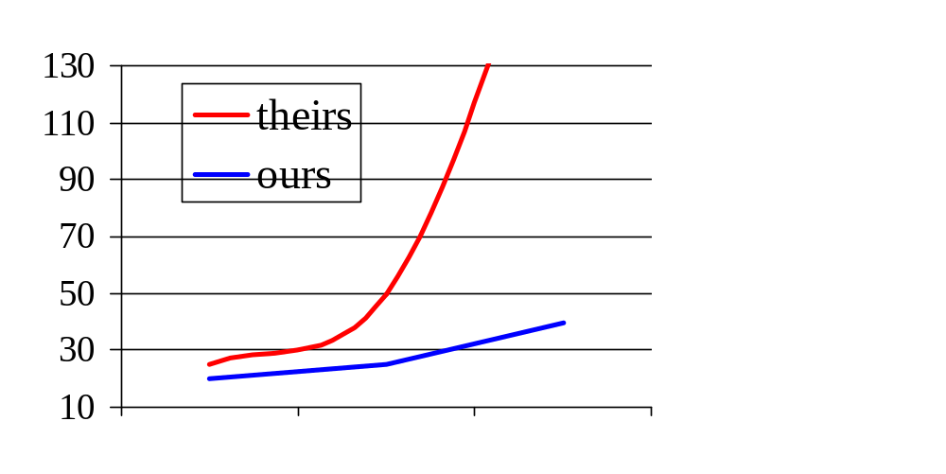
Performance Experiments (1)
throughput, response time, #IOs, CPU, wallclock,
„DB time“, hit rates, space-time integrals, etc.
speed (RT, CPU, etc.)
There are
lies, damn lies, and
workload assumptions
Variations:
instr./message = 10
instr./DB call = 10⁶
latency = 0
uniform access pattern
uncorrelated access
...
load (MPL,
arrival rate, etc.)
25
30
35
40

Slide 5
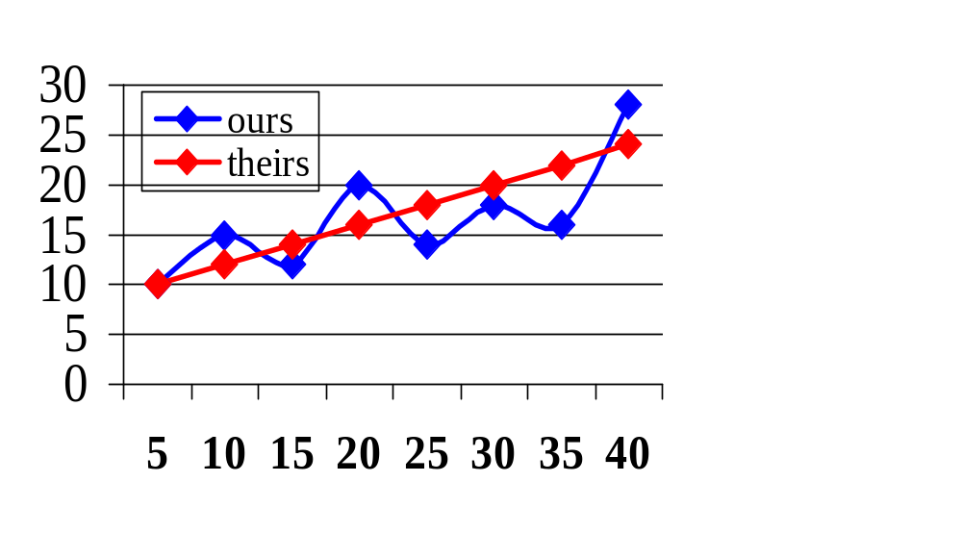
Performance Experiments (2)
If you can‘t reproduce it,
run it only once

Slide 6
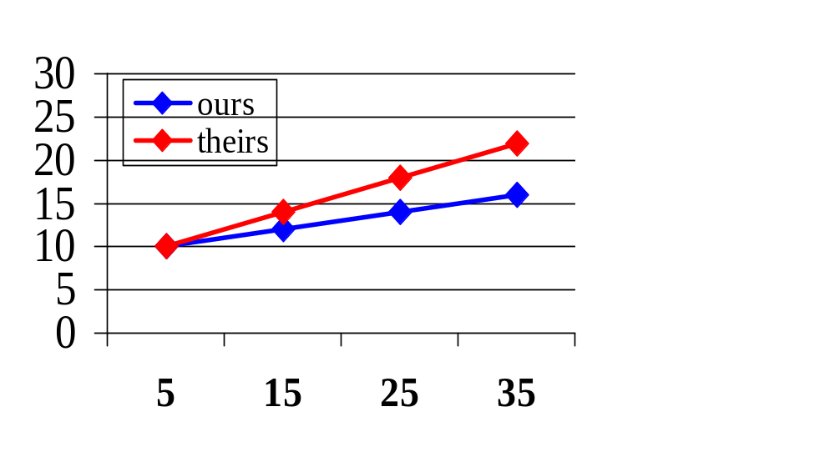
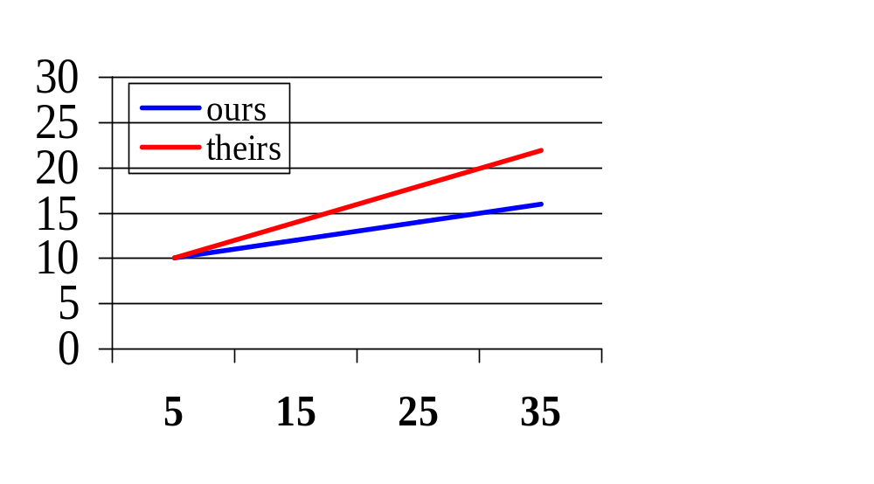
Performance Experiments (2)
If you can‘t reproduce it,
run it only once
and smoothe it

Slide 7
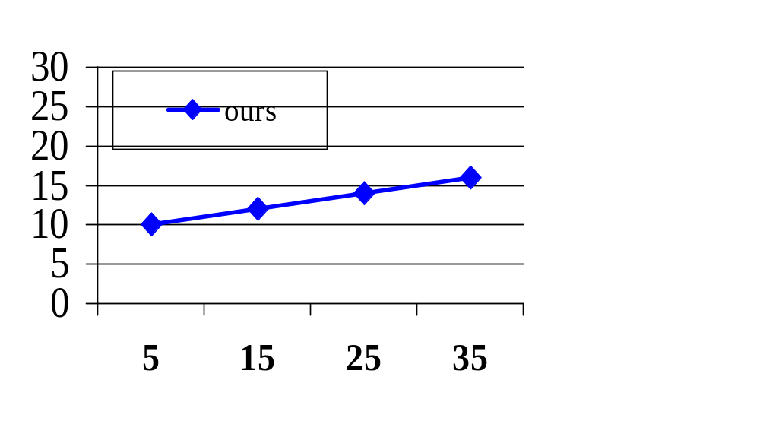
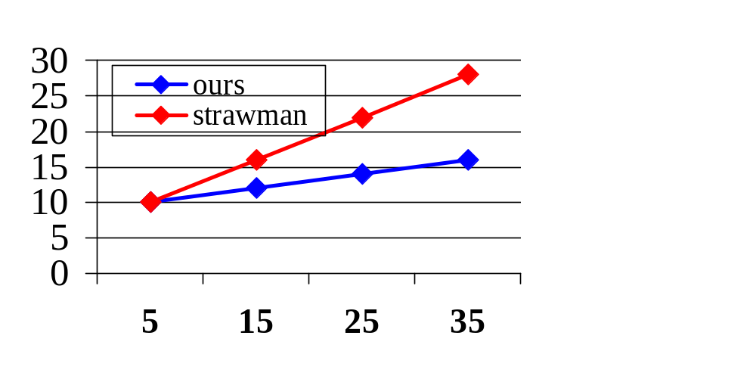
Performance Experiments (3)
Lonesome winner:
If you can‘t beat them,
cheat them
90% of all algorithms
are among the best 10%
93.274% of all statistics
are made up

Slide 8
Result Quality Evaluation (1)
precision, recall, accuracy, F1, P/R breakeven points,
uninterpolated micro-averaged precision, etc.
Political
correctness:
don‘t worry, be happy
TREC* Web topic distillation 2003:
1.5 Mio. pages (.gov domain)
50 topics like
„juvenile delinquency“, „legalization marijuana“, etc.
winning strategy:
weeks of corpus analysis,
parameter calibration for given queries, ...
recipe for overfitting, not for insight
no consideration of DB performance (TPUT, RT) at all
* by and large systematic, but also anomalies

Slide 9
Result Quality Evaluation (2)
IR on non-schematic XML
INEX benchmark:
12 000 IEEE-CS papers
(ex-SGML) with >50 tags
like <sect1>, <sect2>, <sect3>
<par>, <caption>, etc.
There are
benchmarks,
ad-hoc experiments,
and rejected papers
vs.
ad hoc experiment on Wikipedia encyclopedia (in XML)
200 000 short but high-quality docs
with >1000 tags like <person>, <event>, <location>,
<history>, <physics>, <high enery physics>, <Boson>, etc.
if no standard benchmark
⇒ no place at all for off-the-beaten-paths approaches ?

Slide 10
Experimental Utopia
Every experimental result is:
fully documented (e.g., data, SW public or @ notary)
reproducible by other parties (with reasonable effort)
insightful in capturing systematic or app behavior
gets (extra) credit when reconfirmed
partial role models:
TPC, TREC, Sigmetrics?, KDD cup?
HCI, psychology, ... ?

Slide 11
Proposed Action
Critically need experimental evaluation methodology
of performance/quality tradeoffs in research on
semistructured search, data integration, data quality,
Deep Web, PIM, entity recognition, entity resolution,
P2P, sensor networks, UIs, etc. etc.
raise awareness (e.g., through panels)
educate community (e.g., curriculum)
establish workshop(s), CIDR track?

